Slide 1

A Report on Analysis on Impact of Air Pollution Before Lockdown vs After Lockdown.
By Monalisa Panda

Slide 2
The nationwide Lockdown, in effect since the midnight of 24th March in view of COVID-19 pandemic, has resulted in significant improvement in air quality in the country, as revealed by data analysis and comparison of data for time before enforcement of restrictions. This report is in continuation of the same. The major sectors contributing to air pollution are transport, industries, power plants, construction activities, biomass & refuse burning, road dust resuspension and residential activities. In addition, certain activities such as operation of DG sets, restaurant, landfill fires, etc. also contribute to air pollution. Under the nationwide lockdown, all transport services – road, air and rail were suspended with exceptions for essential services. Educational institutions, industrial establishments and hospitality services were also suspended. As a result, air quality improvement has been noted in many towns and cities across the nation. The Data for this Report has been collected from CPCB. In this report Different types of air pollutants are analyzed and also what will be the upcoming effect of Air Pollution that is described in this report.
AIR POLLUTION:-

Slide 3
Causes of Air Pollution:-
These are the causes of air pollution mentioned below
Industry:-
Industries are a major contributor to air pollution. Industrial processes discharge pollutants such as nitrous oxide, Sulphur dioxide and hydrofluorocarbons into the air. Petroleum refineries also liberate lots of hydrocarbons into the air.
Vehicle Emission
Vehicle emissions are another source of fossil fuel emissions which invariably leads to air pollution. Emissions from automobile engines hold both primary and secondary Pollutants.
Household and Farming Chemicals
Fumigating homes, crop dusting, painting supplies, household cleaning products, over the counter insect/pest killers, fertilizer dust, all of these emit harmful chemicals into the air and lead to pollution.

Slide 4

Proposed Approach:-
Collection of Data
Data Pre-processing
Exploratory Data Analysis
Data Visualisation
Results
Time Series Forecasting
Predictive Analysis

Slide 5

Methods and Techniques involved:-
Collection of data:
The data has been collected from Kaggle. The dataset has 16 columns with more than 25k rows.
Data pre-processing:
Data preprocessing is a data mining technique that involves transforming raw data into an understandable format. In this method we get to know our data in a better way.
Exploratory Data Analysis:
In EDA, we generally transform our data to be ready for ML models.(for example:- Remove NULL values, converting categorical to numerical etc.)
Predictive Analysis:
Predictive analytics is the use for statistics and machine learning techniques to predict about the future (unknown data). The goal is to predict the probable future through past experience. Similarly in our analysis, predictive analysis has been done by implementing time series forecasting.
Time Series Fore Casting:
Time series forecasting is used for analyzing time series data in order to study the behavior of data with respect to time. This method involves the use of a model to forecast future values on the basis of previously observed values.

Slide 6
Sulfur dioxide affects human health when it is breathed in. It irritates the nose, throat, and airways to cause coughing, wheezing, shortness of breath, or a tight feeling around the chest. The effects of sulfur dioxide are felt very quickly and most people would feel the worst symptoms in 10 or 15 minutes after breathing it in.
Those most at risk of developing problems if they are exposed to sulfur dioxide are people with asthma, Cardiovascular disease or similar conditions.
Sulphur Dioxide(SO2): -

Slide 7
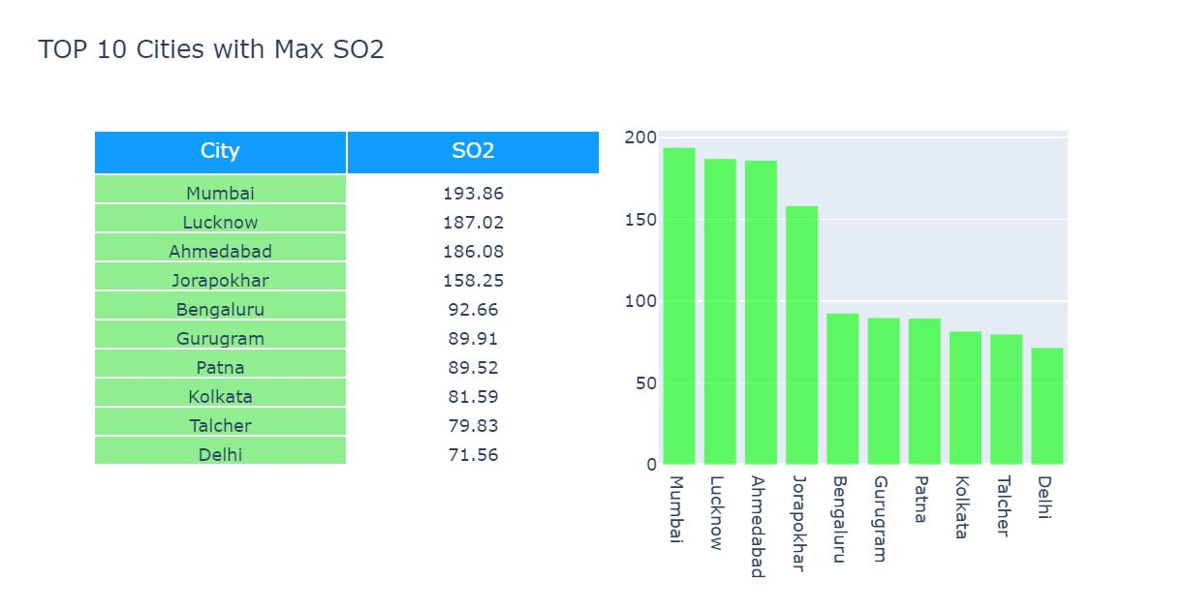
These are the Top 10 Cities Having Maximum amount if SO2.
SO2 in Top 10 Cities:-

Slide 8
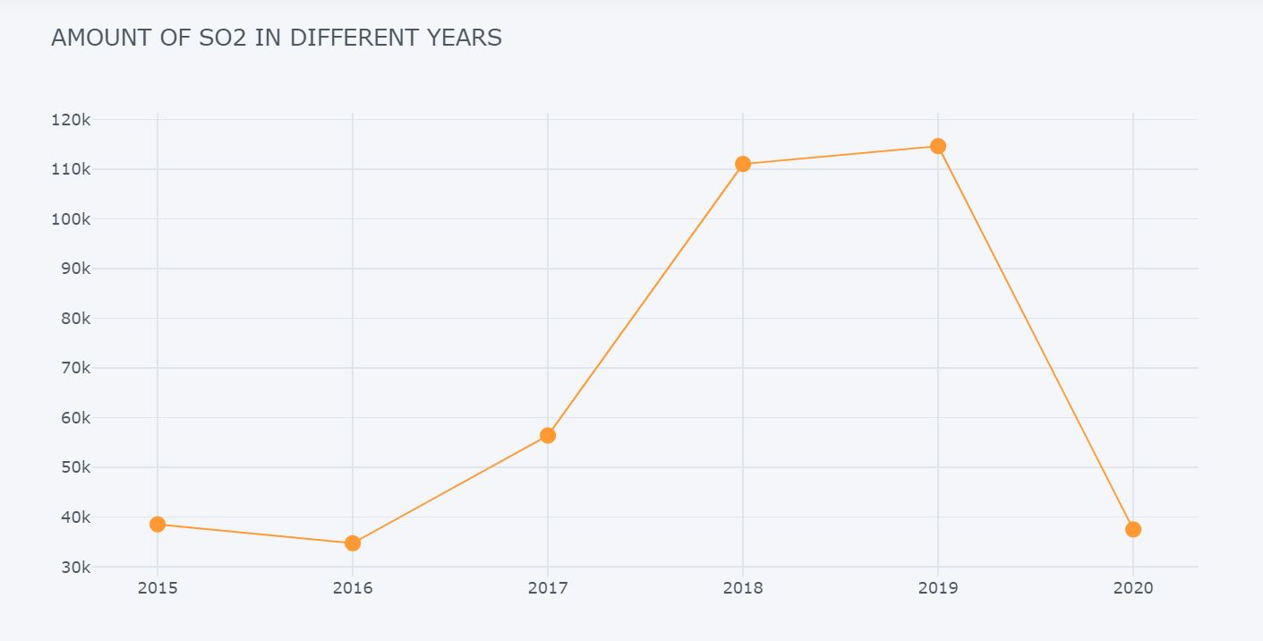
This graph shows How SO2 changes in different years
SO2 Yearly:-
This graph Shows that there is Drastic change in SO2 in the year of 2020.

Slide 9
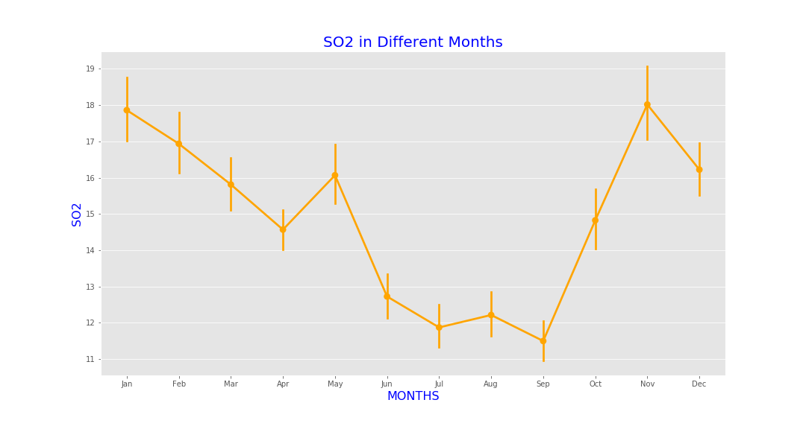
This Graph Shows How SO2
Changes in different Months.

Slide 10
Nitrogen Dioxide(NO2):-
The main effect of breathing in raised levels of nitrogen dioxide is the increased likelihood of respiratory problems. Nitrogen dioxide inflames the lining of the lungs, and it can reduce immunity to lung infections. This can cause problems such as wheezing, coughing, colds, flu and bronchitis.
Increased levels of nitrogen dioxide can have significant impacts on people with asthma because it can cause more frequent and more intense attacks. Children with asthma and older people with heart disease are most at risk.

Slide 11
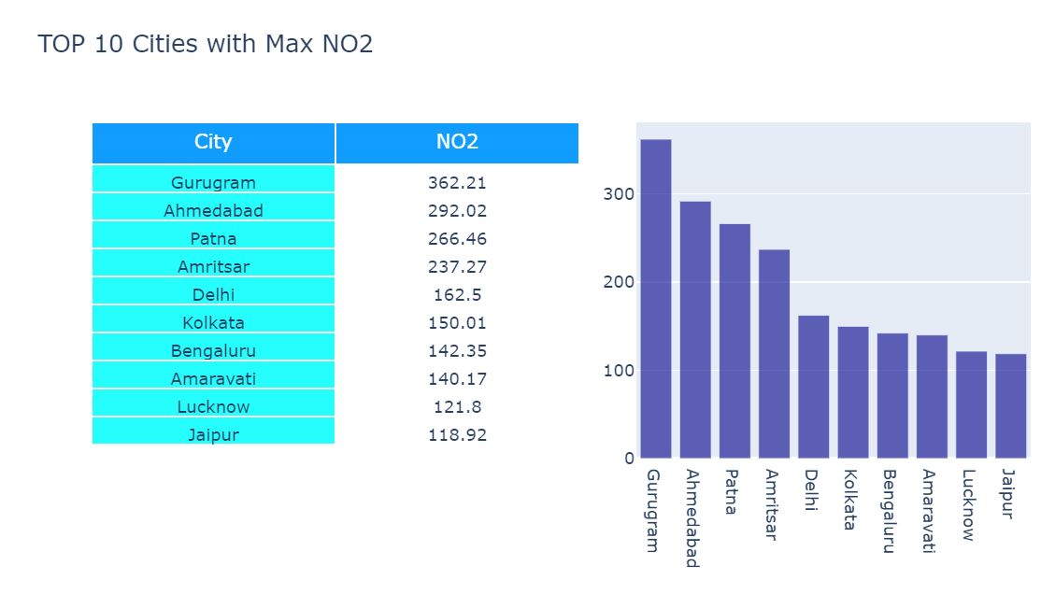
NO2 In Top 10 Ctities
These are the top 10 Cities With Maximum Mount of NO2 Air Pollutant

Slide 12
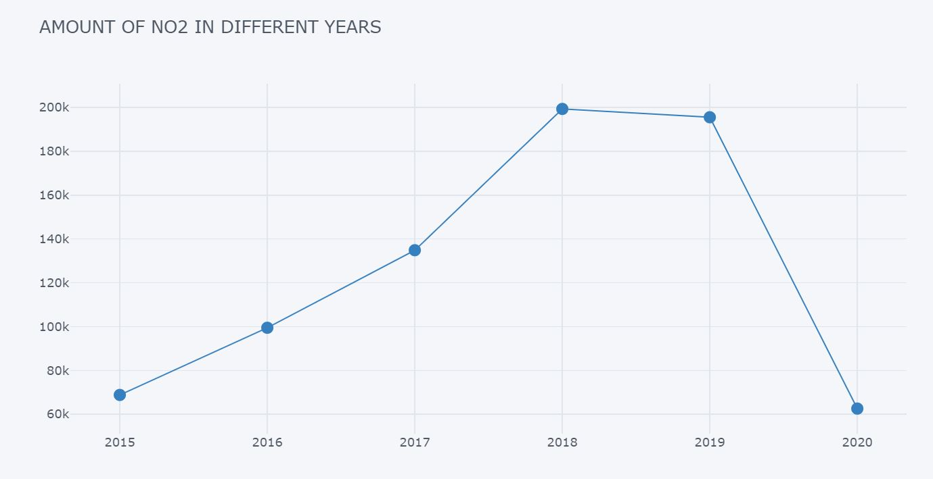
NO2 Yearly
This graph shows how NO2 changes Yearly

Slide 13
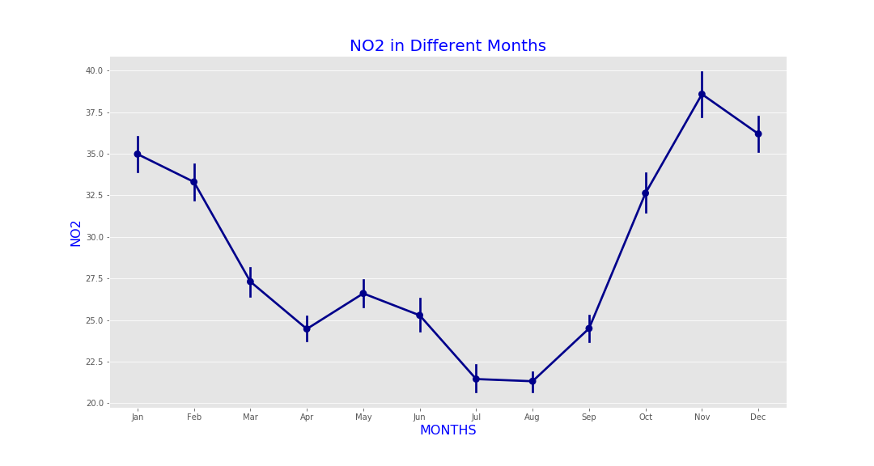
NO2 Monthly
This graph shows NO2 Changes in Different Months.

Slide 14
Carbon Monoxide(CO):-
Breathing air with a high concentration of CO reduces the amount of oxygen that can be transported in the blood stream to critical organs like the heart and brain.
At very high levels, which are possible indoors or in other enclosed environments, CO can cause dizziness, confusion, unconsciousness and death.

Slide 15
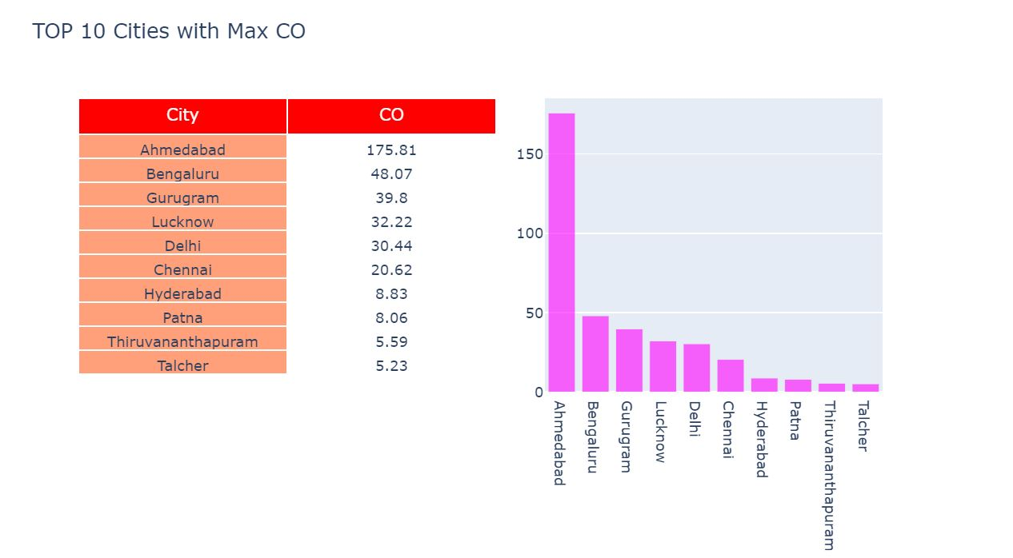
CO In Top 10 Cities
These are the Top 10 cities contains maximum amount of CO

Slide 16
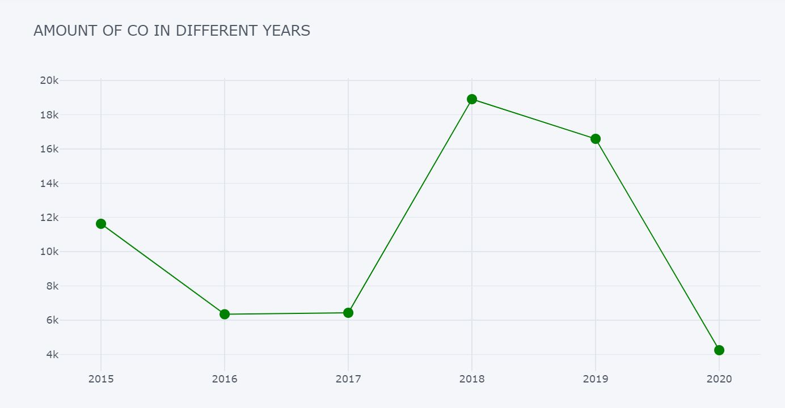
CO Yearly
This Graph shows the changes of CO in Different years.

Slide 17
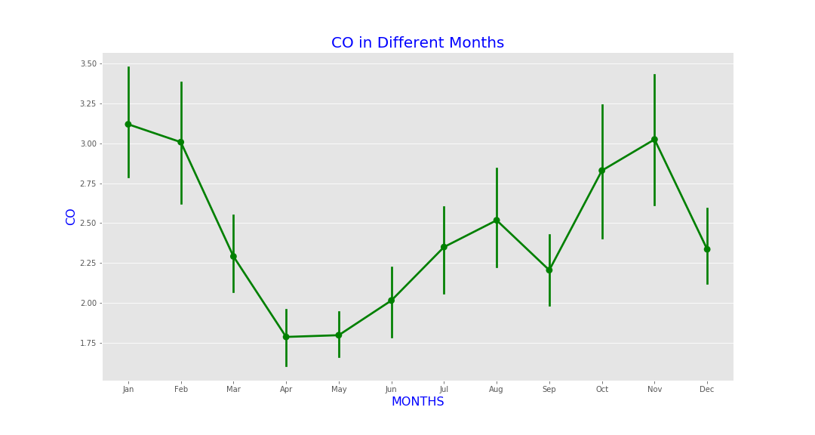
CO Monthly
This graph shows how CO change in different Months.

Slide 18
Particulate Matter(PM2.5):-
Inhalation of particulate pollution can have adverse health impacts, and there is understood to be no safe threshold below which no adverse effects would be anticipated.
The biggest impact of particulate air pollution on public health is understood to be from long-term exposure to PM_{2.5}, which increases the age-specific mortality risk, particularly from cardiovascular causes.

Slide 19
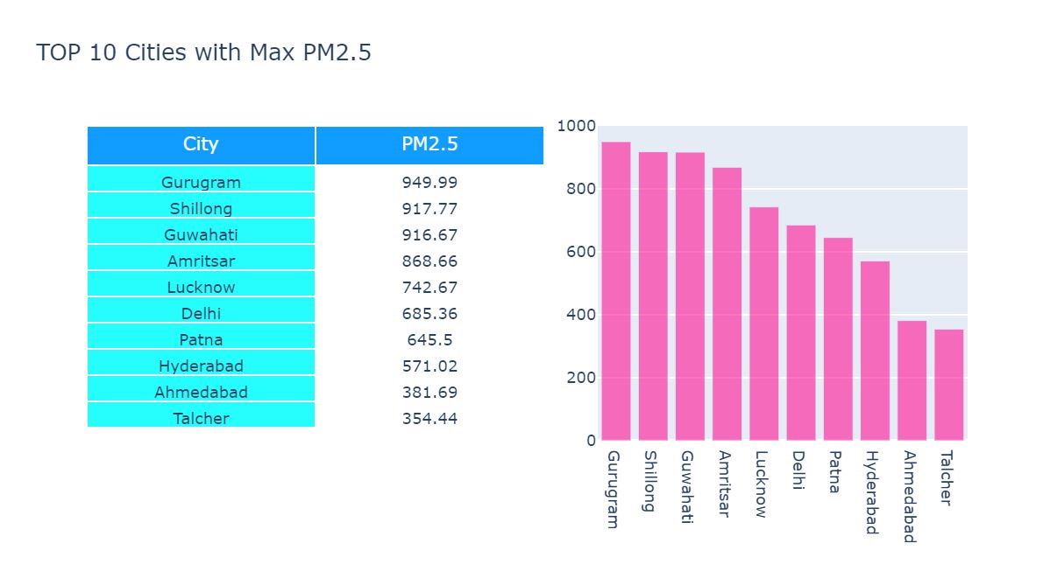
PM2.5 in Top 10 Cities
These are the top 10 cities with maximum PM2.5

Slide 20
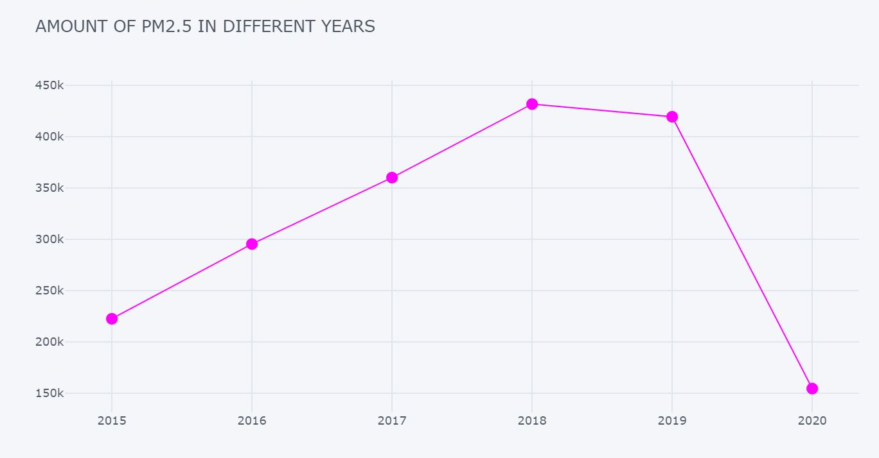
PM2.5 Yearly
Yearly changes Of PM2.5

Slide 21
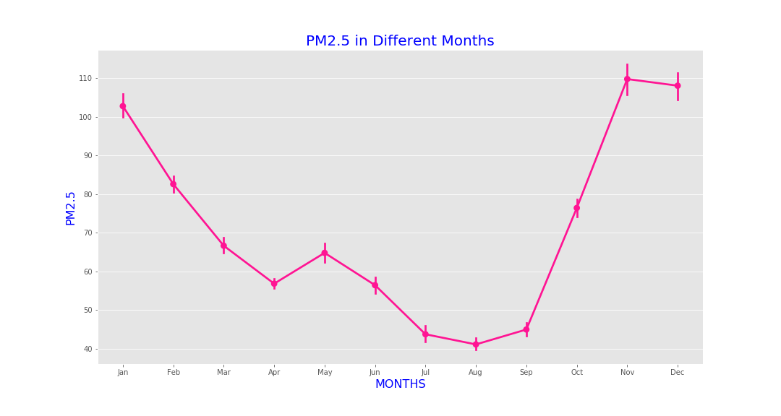
PM2.5 Monthly
Changes of PM2.5 Monthly

Slide 22
Benzene Toluene Xylene(BTX):-
In the present study, the concentrations of three volatile organic compounds (VOCs), namely, acronym for benzene, toluene, and xylenes (BTX) were assessed because of their role in the tropospheric chemistry. Two representative sites, a roadside and a petrol pump, were chosen for sample collection. VOCs were collected using SKC-activated charcoal tubes and SKC personal sampler and characterized by gas chromatograph using flame ionization detector. Among BTX, benzene had the highest concentration

Slide 23
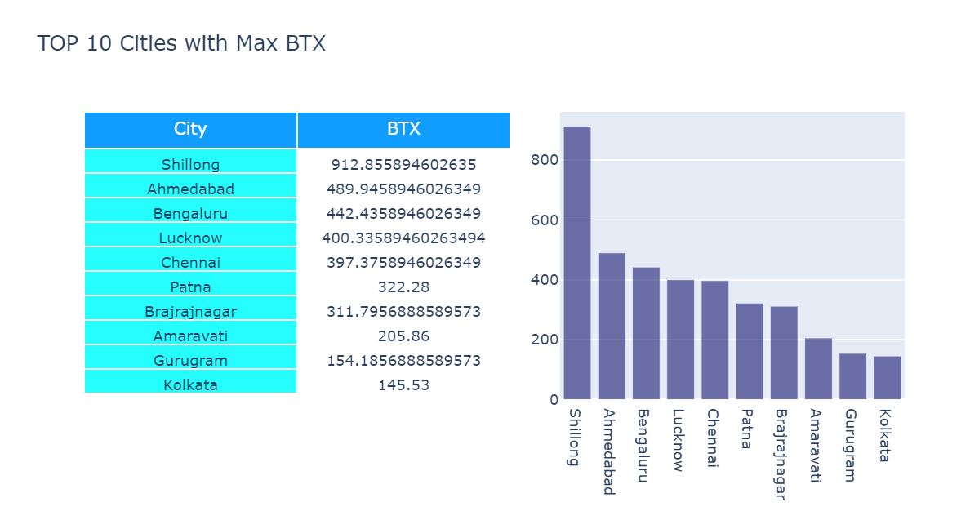
BTX in Top 10 Cities
These are the top 10 cities with maximum amount of BTX

Slide 24
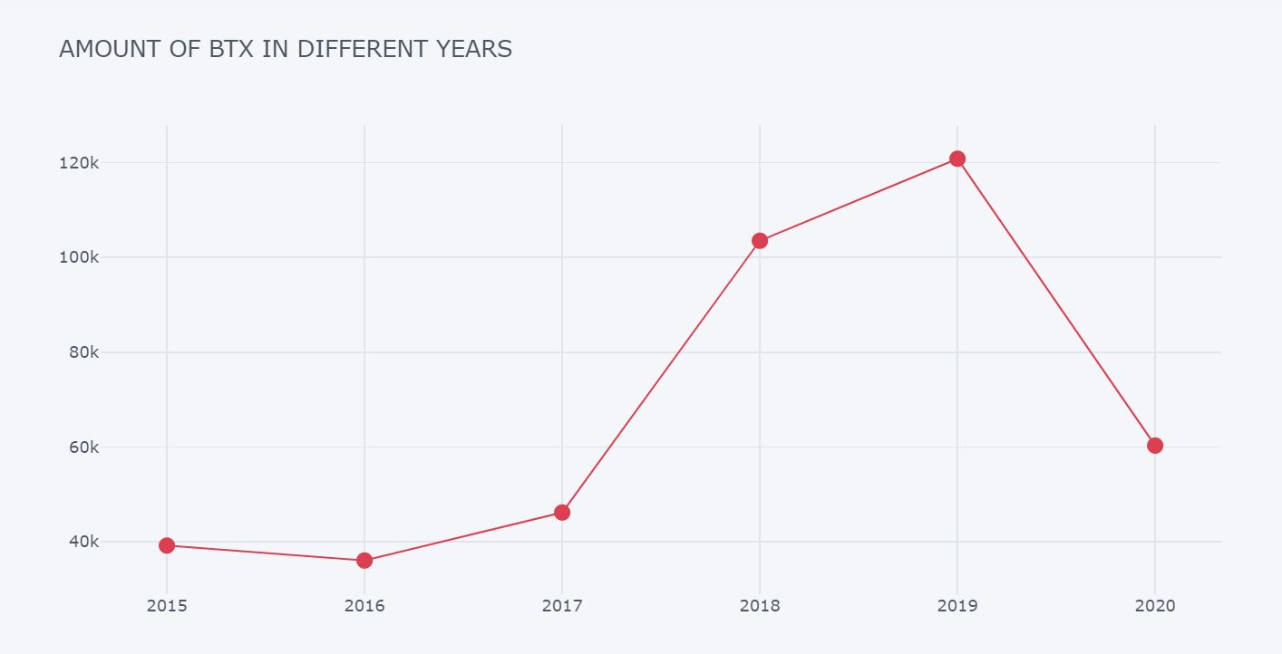
BTX Yearly
This graph shows how BTX changes in different years

Slide 25
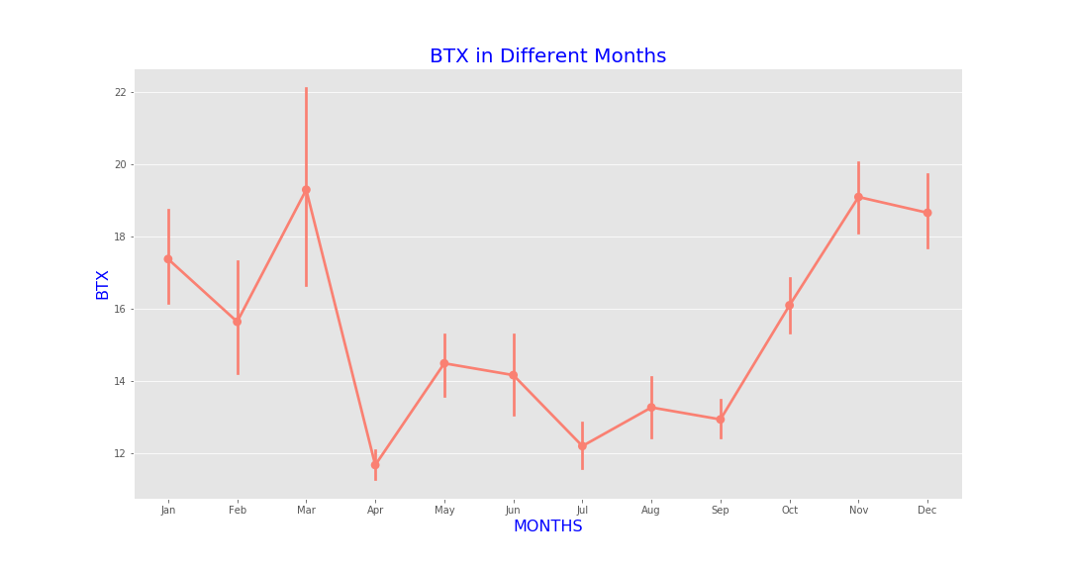
BTX Monthly
This graph shows how BTX changes in different months.

Slide 26
Let’s Analyse The Monthly graphs of all the pollutants
In above all the monthly graphs of all the pollutants, one thing is common and that is in the month of August and September, The amount of pollutants are low, in comparison to other months. That may be due to the amount of monsoon present in the air.

Slide 27
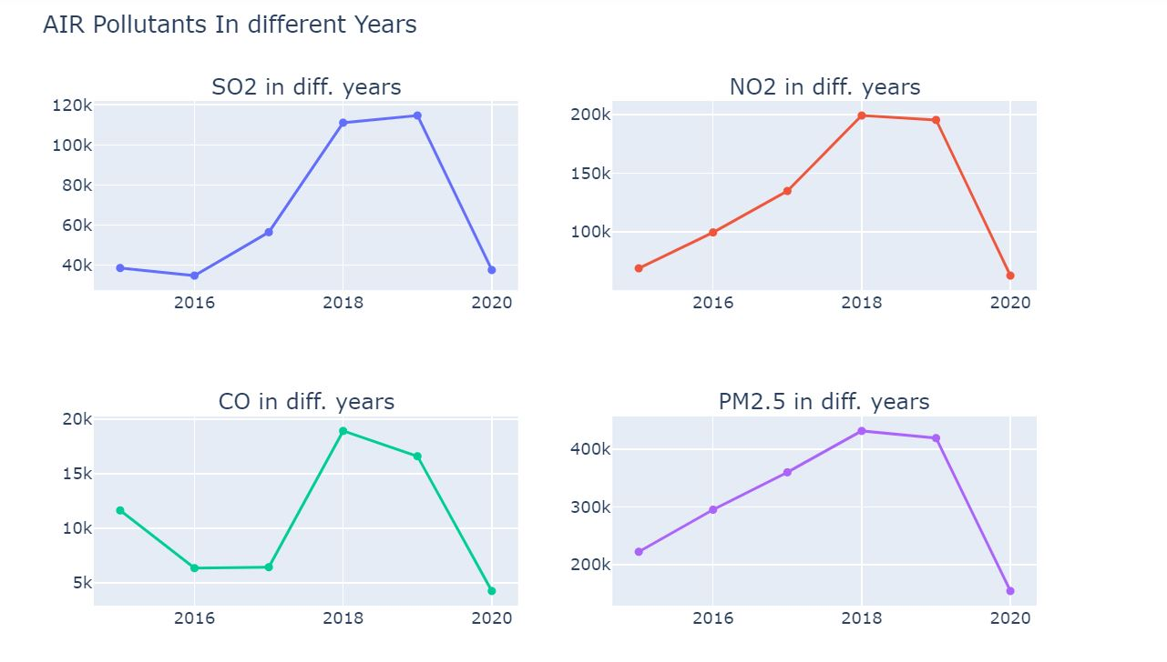
Let’s Compare the Yearly graphs
In all the yearly graphs it’s shown that from the year 2017-2018, all the amount of the pollutants are increased. While in the year of 2020 there is a sudden decrease in all the pollutants. (Due to lockdown).

Slide 28
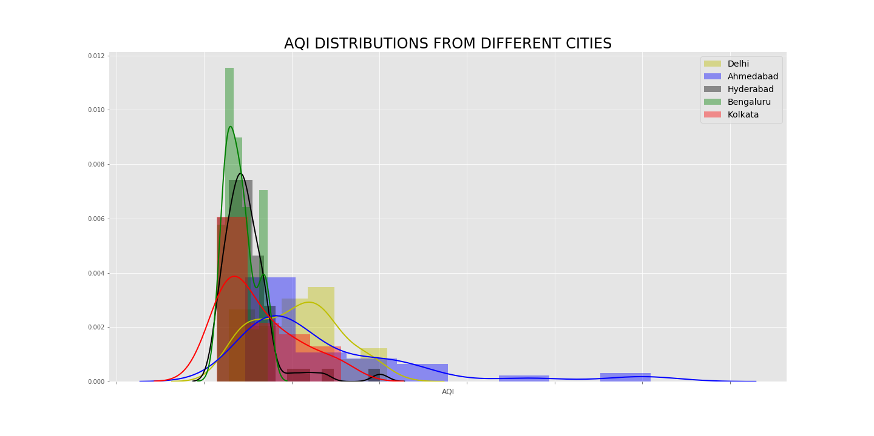
Let’s visualize the AQI Distributions in 5 different cities
Here the 5 different cities taken are Ahmedabad, Delhi, Bengaluru, Kolkata and Hyderabad.
In this Graph the AQI distributions is shown for these 5 different cities.

Slide 29
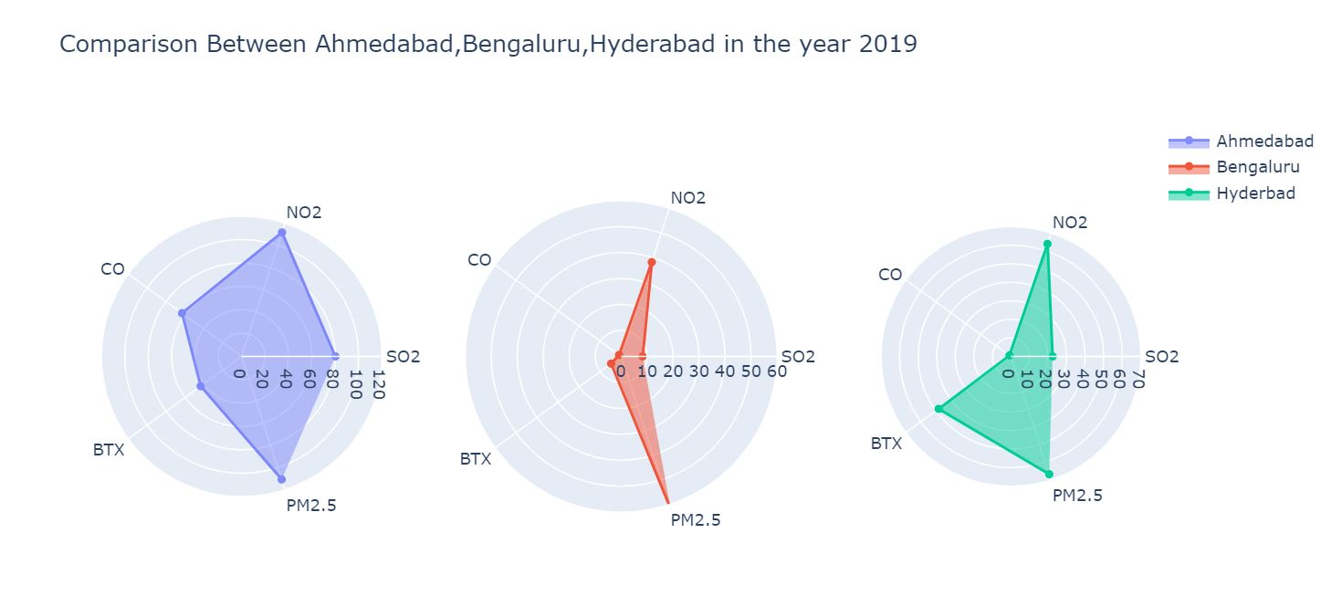
Let’s Compare Pollutants in 3 Cities 2019 vs 2020
This graph is the amount of all pollutants of the cities Ahmedabad, Bengaluru, Hyderabad in the year of 2019.

Slide 30
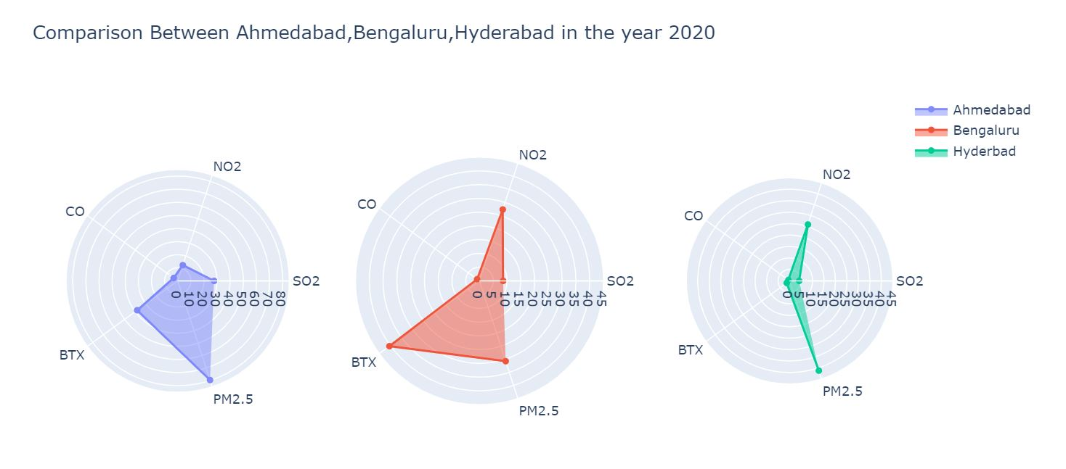
Comparison of the Pollutants in 2020
This graph is the amount of all pollutants of the cities Ahmedabad, Bengaluru, Hyderabad in the year of 2020.

Slide 31
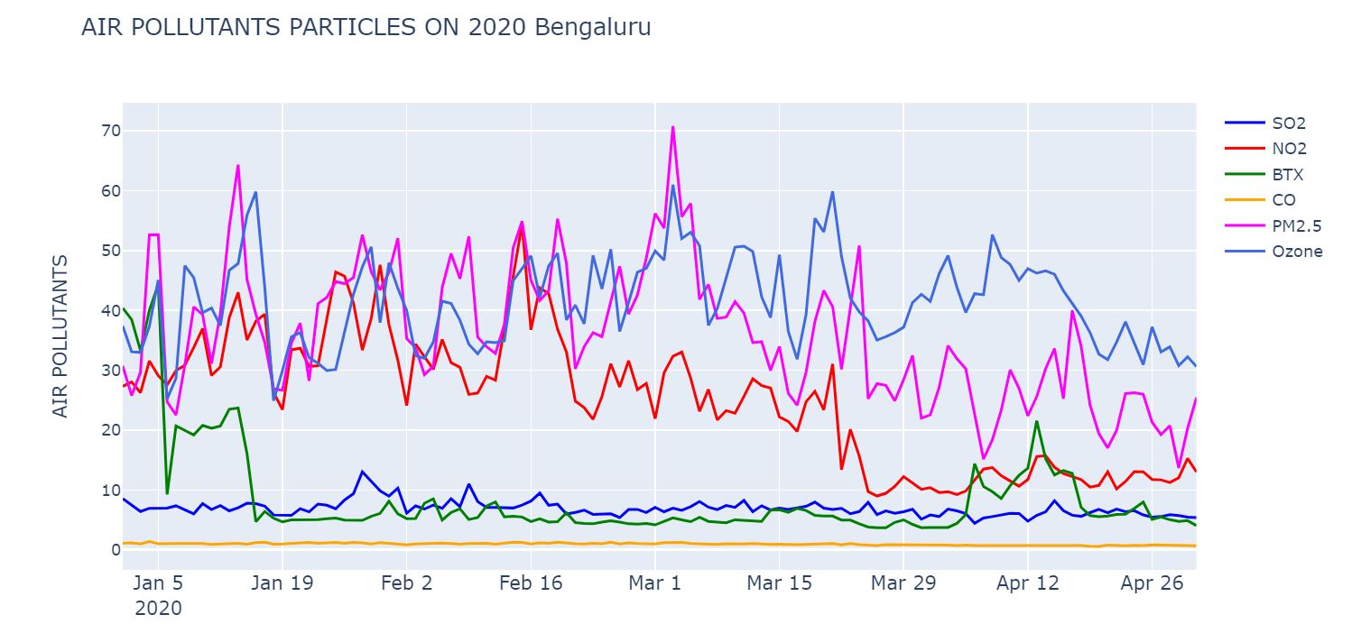
Pollutants Before Lockdown vs after Lockdown in Bangalore
This below graph shows all the pollutants level changes from Jan2020 to May 2020. You can see how the pollutants level decreases when the Lockdown started.

Slide 32
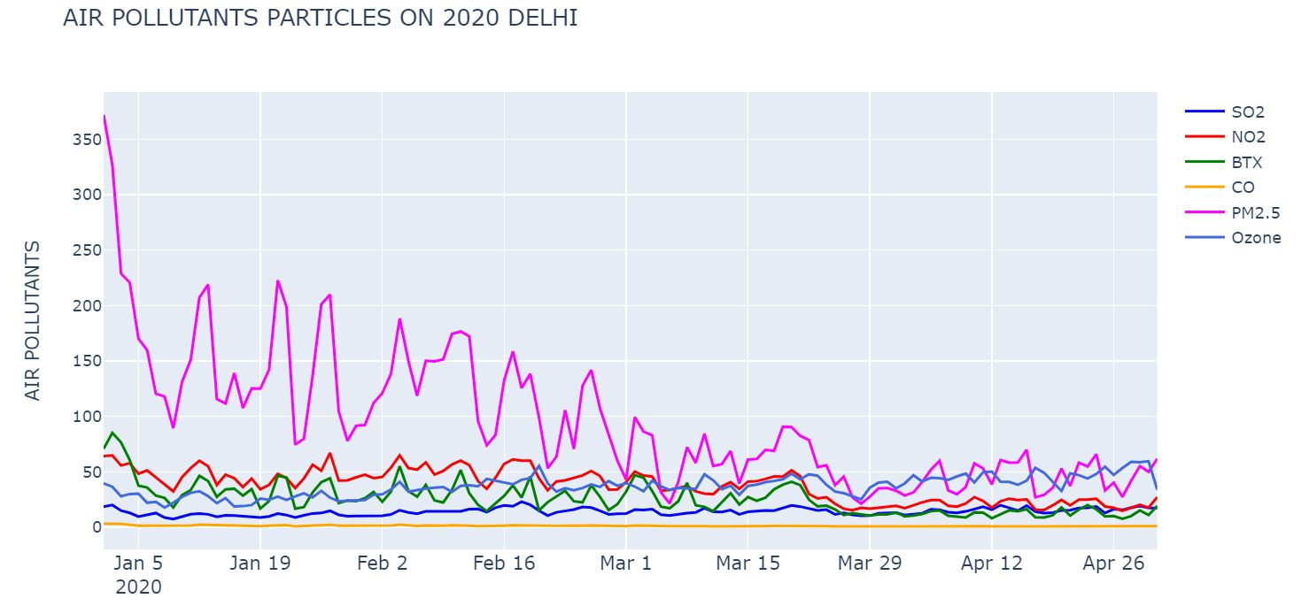
Pollutants Before Lockdown vs after Lockdown in Delhi
This below graph shows all the pollutants level changes from Jan2020 to May 2020. You can see how the pollutants level decreases when the Lockdown started.

Slide 33
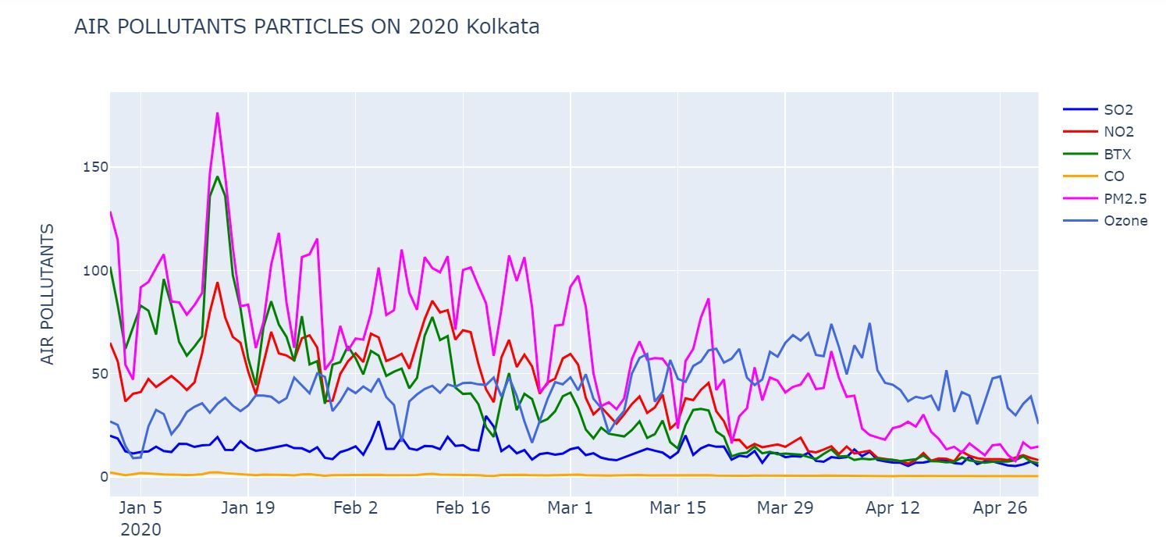
Pollutants Before Lockdown vs after Lockdown in Kolkata
This below graph shows all the pollutants level changes from Jan2020 to May 2020. You can see how the pollutants level decreases when the Lockdown started.

Slide 34
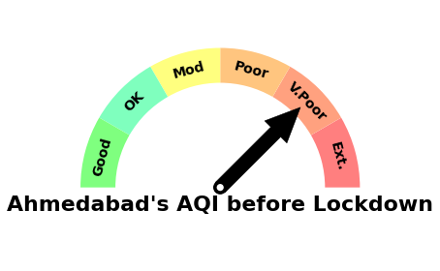
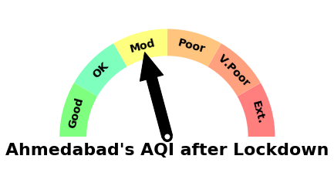
Compare The AQI Levels Before Lockdown vs After Lockdown of Ahmedabad
Before Lockdown
After Lockdown
In the above two figure, it is shown that after lockdown Ahmedabad’s AQI level changes to Moderate from Very poor.

Slide 35
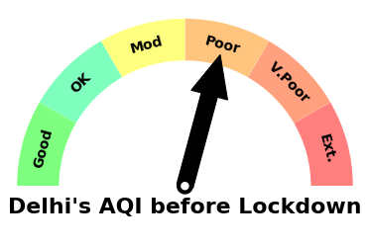
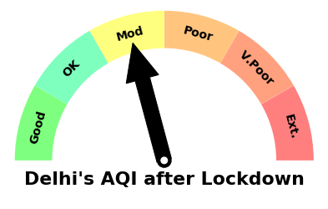
Compare The AQI Levels Before Lockdown vs After Lockdown of Delhi
Before Lockdown
After Lockdown
In the above two figure, it is shown that after lockdown Delhi’s AQI level changes to Moderate from poor.

Slide 36
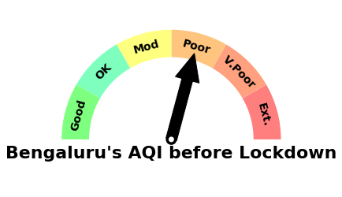
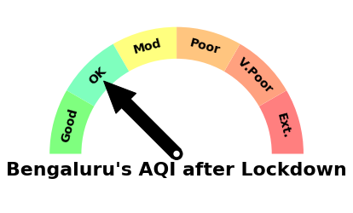
Compare The AQI Levels Before Lockdown vs After Lockdown of Bengaluru
In the above two figure, it is shown that after lockdown Bengaluru’s AQI level changes to Ok from Poor.

Slide 37
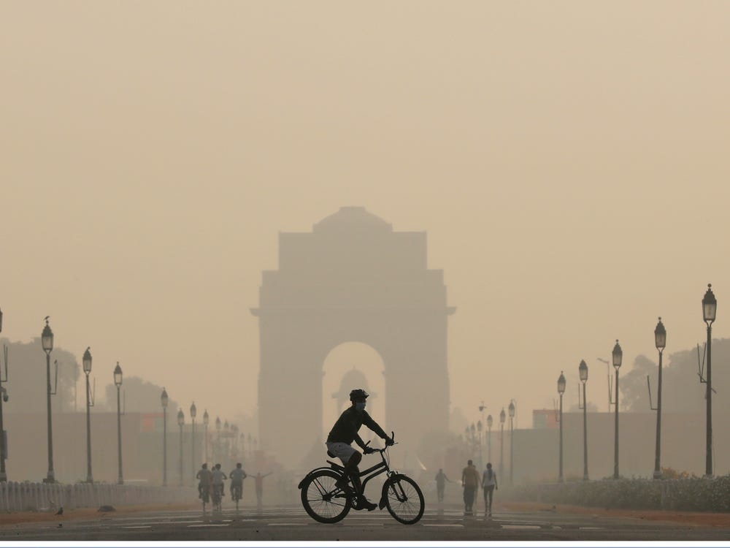
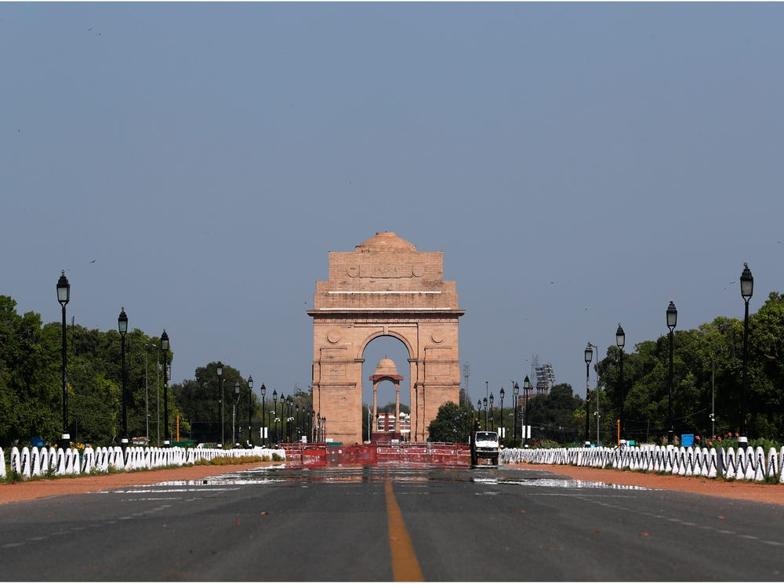
Real time comparison in India
These below pictures are the comparison of air pollution before lockdown vs after lockdown.
Before Lockdown
After Lockdown

Slide 38
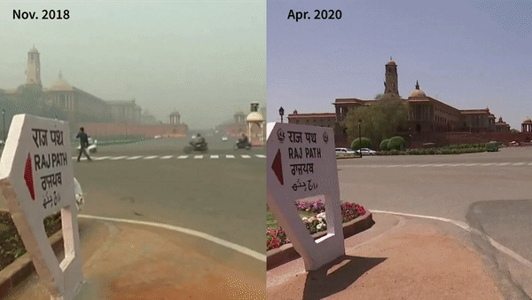
Real Scenario in changes of air pollution.
This GIF shows how ,much amount of improvement happened in air pollutants. In this GIF you can see clearly that the pollutants are drastically decreased and so the path is so clearly visible in 2020 in comparison to other years.

Slide 39
Impact of Air Pollution Post Corona(2020-2023)
Time Series Forecasting
Time series forecasting is used for analyzing time series data in order to study the behavior of data with respect to time. This method involves the use of a model to forecast future values on the basis of previously observed values.
In this report to analyze post corona(2020-2023), this time series forecasting is used (Using prophet library).
Facebook prophet is a library developed by Facebook core data science team.
Based on the historic dataset, we can build a time series model and then predict the outcome for future.

Slide 40
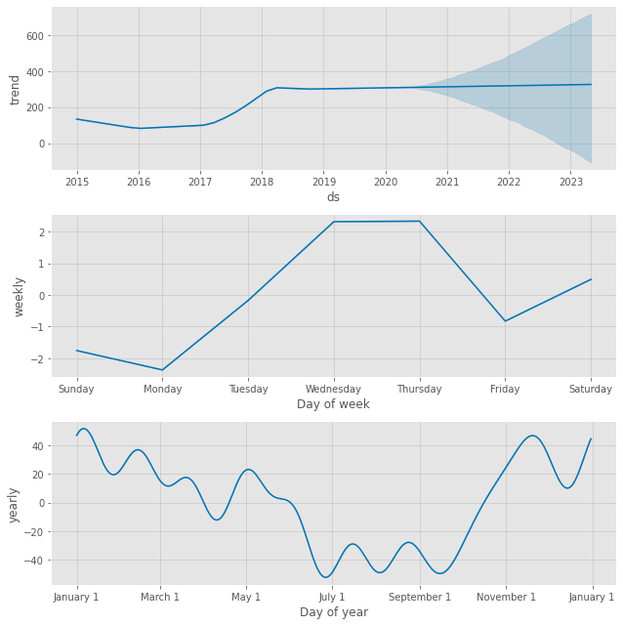
Let’s Analyze changes SO2 pollutant in upcoming years
The SO2 pollutant changes in upcoming years.
If we analyze the years the we can see the constant line from the year 2020-2023.(Prediction using Time series forecasting).
If we analyze the days then it will be low in Monday.
If we analyze the months it’s like to be low in the month from Aug-sept.

Slide 41
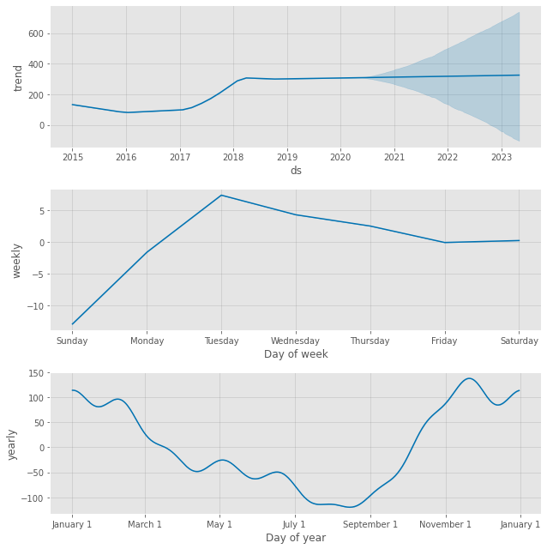
Let’s Analyze changes NO2 pollutant in upcoming years
The NO2 pollutant changes in upcoming years.
If we analyze the years the we can see the constant line from the year 2020-2023.(Prediction using Time series forecasting).
If we analyze the days then it will be low in Sunday.
If we analyze the months it’s like to be low in the month from Aug-sept.

Slide 42
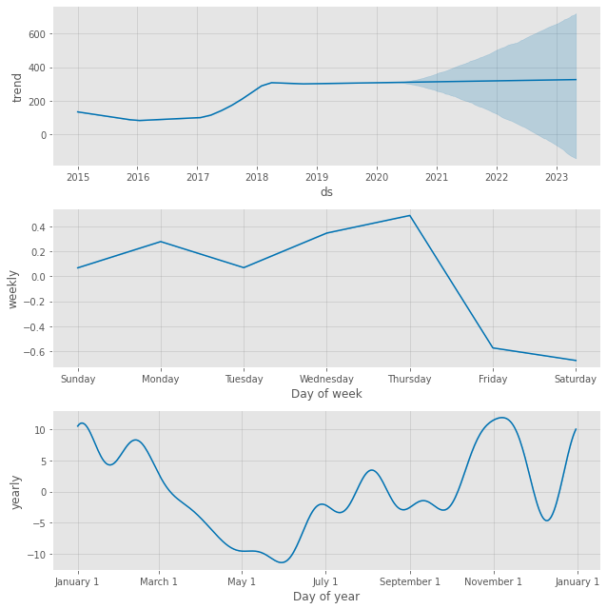
Let’s Analyze changes CO pollutant in upcoming years
The CO pollutant changes in upcoming years.
If we analyze the years the we can see the constant line from the year 2020-2023.(Prediction using Time series forecasting).
If we analyze the days then it will be low in Saturday.
If we analyze the months it’s like to be low in the month of July.

Slide 43
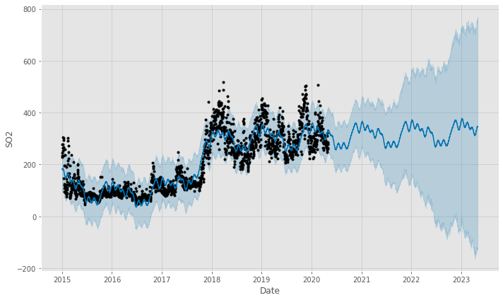
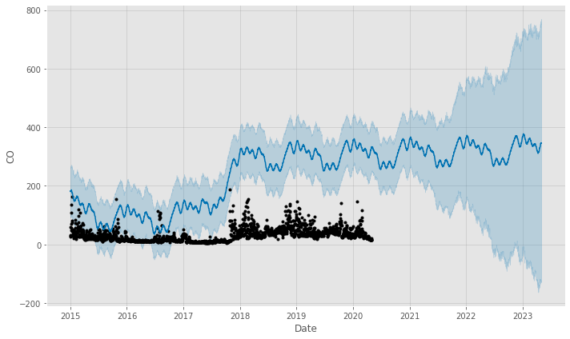
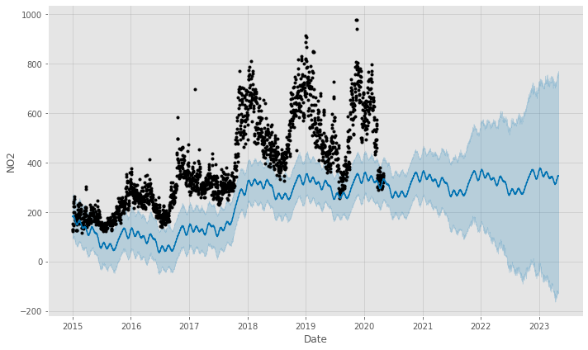
Fig-2: SO2
Fig-1: CO
Fig-1: NO2

Slide 44
Summary
During the lockdown period, there has been a general improvement in air quality in the country as a result of the restrictions imposed during the lockdown, which is corroborated by Air Quality Index data. All of the major cities, analyzed in this report, had their AQI, largely within Good-Very poor categories, with Bengaluru, Delhi and Ahmedabad recording all the days of the lockdown period in Good-ok categories.
Coming to The time series forecasting(The prediction part). We have analysed the impact of air pollutants in different years. From there we got a constant result of the changes of air pollutants in upcoming years, also we have seen that the amount air pollutants is quite low in weekend in comparison to weekdays. This might be due to the holidays, because of holidays industries are closed and also all the private sectors, hence decrease the population, hence leads to less pollution.
The results proposed are based on the historic data, hence cannot take account the future events that can manipulate the proposed results. This Totally Depends upon the Lockdown. When the lockdown will over the vehicles on the road, industries, again started as like before so there might be a chance that the pollution might get increase to the previous level.Atmospheric variables like wind, precipitation, humidity do not remain static which also pose a problem in long range forecasting..
Public plays a ,major role to control air pollution.(Like Usage of CNG while driving, plantation, etc.). The public need to aware of air pollution and do take necessary steps to control the pollution.

Slide 45

Thank You
By Monalisa Panda

